Slide 1

SEND – how governors ensure pupils’ needs are being met

Slide 2

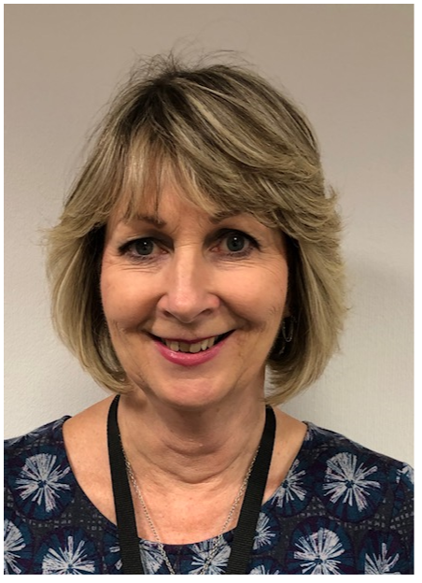

Steve Barker & Linda Waghorn
www.bettergovernor.co.uk

Slide 3
Aims of this session:
to explore the statutory role of maintained schools and academies in meeting the needs of pupils with SEND;
to clarify how governors' and trustees’ monitoring should inform their effective strategic overview;
to outline what governance should monitor and best practice tips on how to ensure SEND pupils needs are being met.

Slide 4
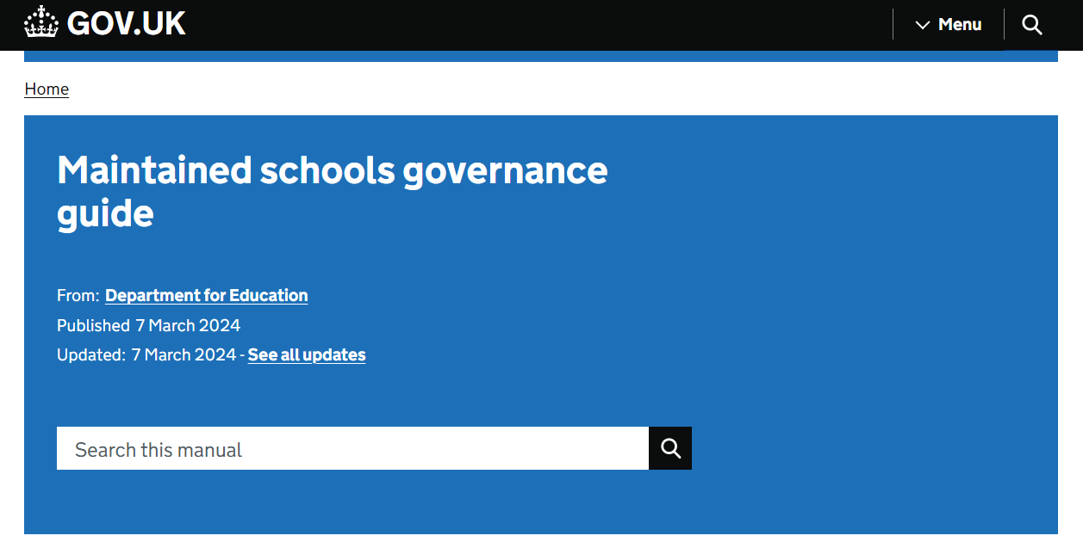
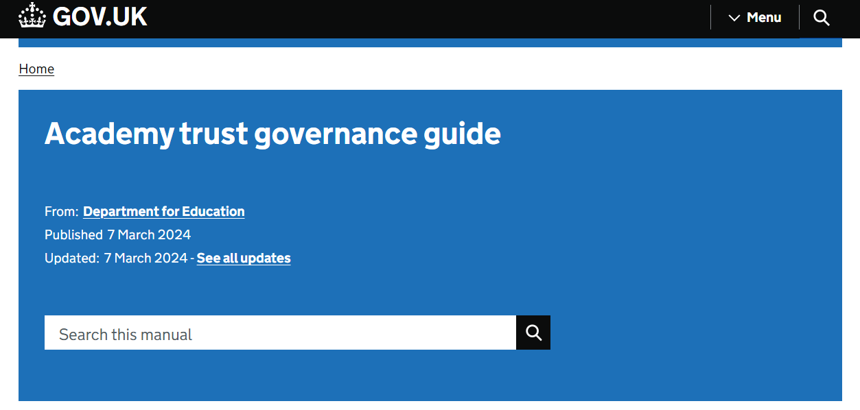
DfE Guidance

Slide 5
DfE Expectations of governance:
ensuring key duties (statutory) are complied with;
a designated governor for SEND (should);
ensure SENDCo has been appointed (mainstream);
have regard to guidance in Code of Practice.

Slide 6

SEND Code of Practice:
‘Our vision for children with special educational needs and disabilities is the same as for all children and young people – that they achieve well in their early years, at school and in college, and lead happy and fulfilled lives.’

Slide 7
What is SEND?
A child or young person has SEN if they have a learning difficulty or disability which calls for special educational provision to be made for him or her.
A child of compulsory school age or a young person has a learning difficulty or disability if he or she:
  has a significantly greater difficulty in learning than the majority of others of the same age; or
  has a disability which prevents or hinders him or her from making use of facilities of a kind generally provided for others of the same age in mainstream schools or mainstream post-16 institutions.
  SEND Code of Practice

Slide 8
SEND Glossary:
SENDCo -SEND Co-Ordinator (SENDCo)- lead for SEND in school;
EHCP - Education & Health Care Plan;
ARP - Additional Resource Provision, in a mainstream school;
LSA - Learning Support Assistant;
IPM - Individual Provision Map
ASD – Autism Spectrum Disorder
High COIN – High functioning Autism communication and interaction needs.

Slide 9
The SENDCo role:
must be a qualified teacher designated as SEND co-ordinator;
National Award for SEN Coordination must be achieved within three years, if new to role;
helps determine strategic development of policy and provision within school;
provides professional guidance to colleagues;
has sufficient time, resources and support.
Notes:
Updated Sept 2024 t reflect new mandatory SENDCo qualification guidance

Slide 10

Meeting needs and knowing needs:
In order to know if we are meeting the needs of children and young people with SEND, we must be aware of numbers and types of need within our school or setting.
Notes:
i.e. all about context

Slide 11
SEND – main areas of need:
Four broad areas of need (CoP):
  communication and interaction;
  cognition and learning;
  social, emotional and mental health;
  sensory and/or physical needs.
Notes:
Use COP page 97 ( have open on t’other screen) to talk in broad terms of what is inc in each area

Slide 12
SEND - the big picture (in your school):
the number of pupils with SEND;
knowing the spectrum of need (context);
support staff deployment;
how the curriculum reflects inclusion;
how enrichment and extra-curricular activities include SEND pupils;
assessment data showing SEND pupils as a discrete group;
a focus on SEND progress.

Slide 13
Having regard to the Code of Practice
All children and young people are entitled to an appropriate education, one that is appropriate to their needs, promotes high standards and the fulfilment of potential. This should enable them to:
  achieve their best:
  become confident individuals living fulfilling lives;
  make a successful transition into adulthood, whether into employment, further or higher education or training.
How should governors seek assurance of these?
Notes:
Having regard to CoP is a stat requirement for all gov bodies/trust boards

Slide 14
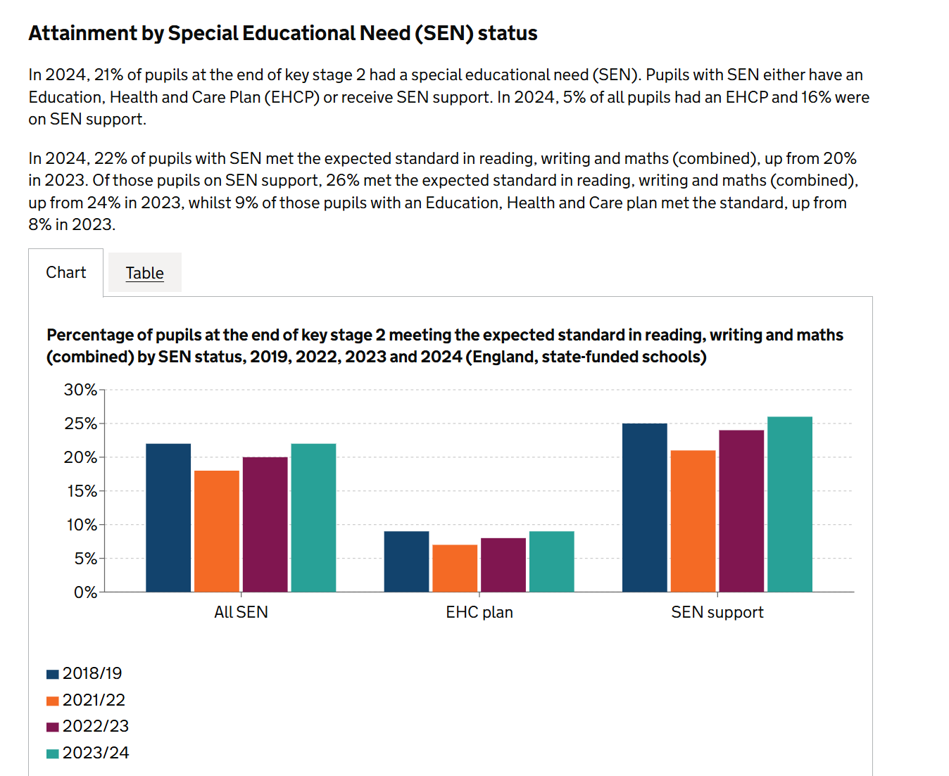
SEND pupils’ achieving their best:
Notes:
This is taken from Key Stage 2 Attainment (2023-24) i.e. last academic (Summer 24) Year tests….

Slide 15
SEND outcomes in your school:
Governor/trustee monitoring should include:
Headteacher reports updating context:
internal assessment data by pupil group;
detailed analysis of end-of-Key Stage data, highlighting attainment and progress of pupils with SEND;
other SEND data (Personal Development etc.)
Notes:
Talk to challenge, how, examples etc

Slide 16
Monitoring SEND pupil progress:
Ensuring SEND pupils progress and attainment is reported on, to governors;
Assessment data reflecting:
  start point (prior attainment);
  attainment (by level of need, if applicable);
  progress;
  actual v target/projected outcomes;
  overlap with other groups (PP, EAL, etc)
Non-academic progress
Notes:
Talk to challenge, how, examples etc

Slide 17
Provision Mapping:
Shows the range of provision available to support learners
Allows the school to monitor evaluate and plan the development of provision for
  Pupils with special educational needs (SEND)
  More able pupils.
  Vulnerable pupils.
  Looked after children.
  Post-looked after children.
Notes:
This should be on your school website – worth looking at your school’s website tyo see what info is there for parents and carers

Slide 18
Individual Provision Mapping:
For each child identified:
clear records of a child’s SEND need(s);
the provision (EHCP section F) put in place for them;
the difference that support is expected to make;
evidence of learner progress;
termly review with class teacher and parents.
Notes:
Govs could see anon versions, but usually GBs should know (maybe Desig SEND Gov) what total cost of SEND provision is. At least for EHCP pupils.

Slide 19

A helpful resource for governance:

Slide 20
Summary:
Governors and trustees must know their school’s context, in terms of groups (esp. SEND);
school budgets include funds specifically for SEND – do we know spending priorities;
value for money is all about pupil outcomes (esp SEND outcomes);
outcomes and provision mapping should evidence needs being met.

Slide 21

Any Questions?

Slide 22
Further information
Governance Guides:
    https://www.gov.uk/guidance/governance-in-maintained-schools
    https://www.gov.uk/guidance/-governance-in-academy-trusts
SEND Code of Practice:
    https://www.gov.uk/government/publications/send-code-of-practice-0-to-25
EEF - SEND in Mainstream Schools:
    https://educationendowmentfoundation.org.uk/education-evidence/guidance-reports/send

Slide 23
Thank you
Please come back next time
Enjoy the remainder of your day.

